Slide 1
Travelling salesman problem
Andrea Mazzolini, Reinforcement learning tutorial, HPC 2020

Slide 2
Statement of the problem
Given 𝑁 cities and all the distances between them, what is the shortest path that passes by all the cities only once, and then go back to the original city? What is the distance travelled on the shortest path?
Best path
1
5
2
1
5
2
3
2
3
2
20
1
20
1
3
6
4
3
6
4

Slide 3
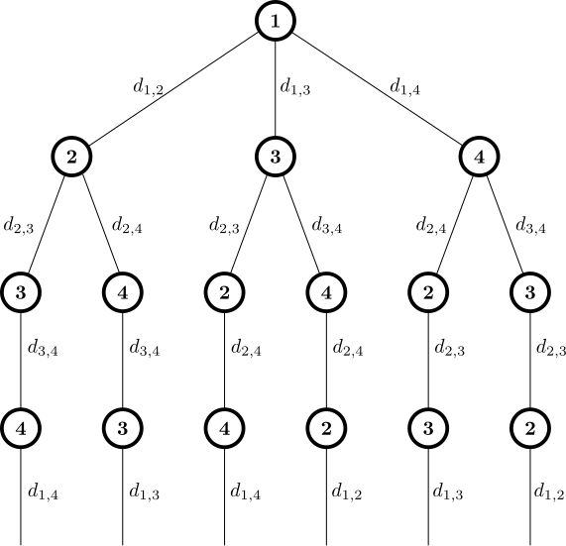
Brute force solution
1
5
2
3
2
20
1
3
6
4
How many paths to enumerate?
16
32
26
32
26
16

Slide 4
Nearest neighbour
Start from the first city
Init a set of unvisited cities
Iterate until unvisited cities is empty:
Choose the next city as the nearest one in the unvisited cities
Remove the city from the unvisited ones
1
5
2
3
2
Not optimal but much faster, O(n²)
20
1
3
6
4

Slide 5
As a Markov Decision Process
Optimal solution found in exponential time (better than brute force)

Slide 6

As a Markov Decision Process
Optimal solution found in exponential time (better than brute force)
Current city I’m in
States: $s=\left(k, A\right)$
List of cities still to be visited

Slide 7
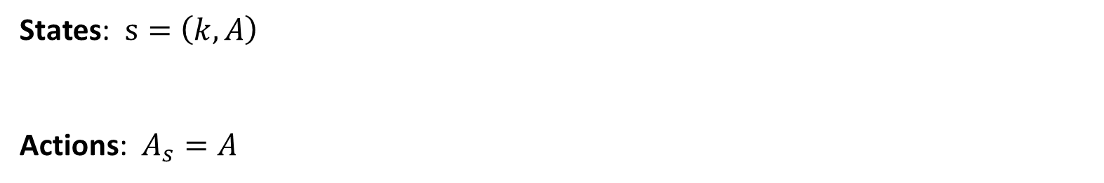
As a Markov Decision Process
Optimal solution found in exponential time (better than brute force)
Current city I’m in
States: $s=\left(k, A\right)$
Actions: $A_{s}=A$
List of cities still to be visited
Choose one city to be visited

Slide 8
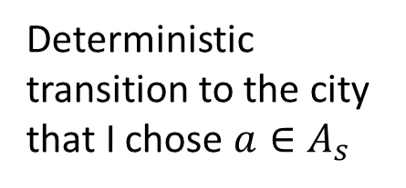
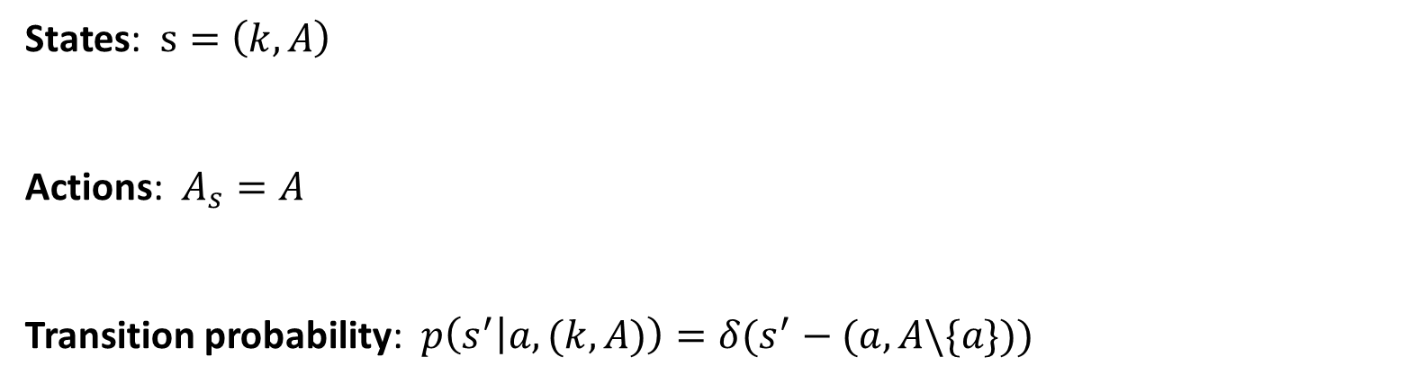
As a Markov Decision Process
Optimal solution found in exponential time (better than brute force)
Current city I’m in
States: $s=\left(k, A\right)$
Actions: $A_{s}=A$
Transition probability: $p\left(s^{′} | a,(k,A)\right)=δ(s^{′}−(a,A\backslash \{a\}))$
List of cities still to be visited
Choose one city to be visited
Deterministic transition to the city that I chose $a∈A_{s}$

Slide 9


As a Markov Decision Process
Optimal solution found in exponential time (better than brute force)
Current city I’m in
States: $s=\left(k, A\right)$
Actions: $A_{s}=A$
Transition probability: $p\left(s^{′} | a,(k,A)\right)=δ(s^{′}−(a,A\backslash \{a\}))$
Reward: $r\left(\left(a,A\backslash \{a\} \right),\left(k,A\right)\right)={−d}_{k,a}$
List of cities still to be visited
Choose one city to be visited
Deterministic transition to the city that I chose $a∈A_{s}$
Minus distance from $k$ to $a$

Slide 10
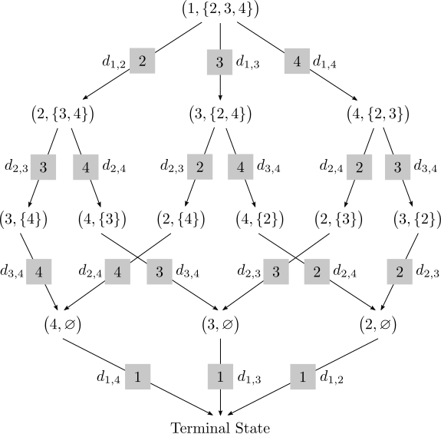

As a Markov Decision Process
Current city I’m in
States: $s=\left(k, A\right)$
List of cities still to be visited
1
5
2
3
2
20
1
3
6
4

Slide 11
As a Markov Decision Process
Current city I’m in
States: $s=\left(k, A\right)$
List of cities still to be visited
1
5
2
3
2
20
1
3
6
4

Slide 12
As a Markov Decision Process
Current city I’m in
States: $s=\left(k, A\right)$
List of cities still to be visited
Small exercise: diagram of all the transition, how many are them? (cost for memory)

Slide 13
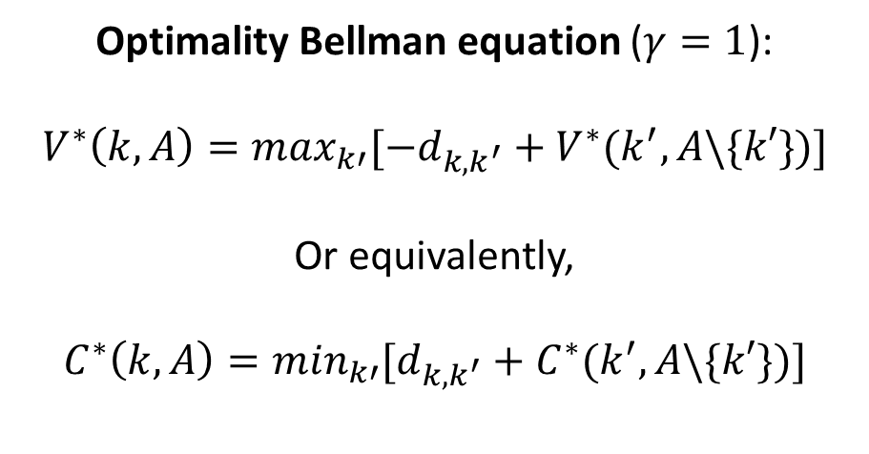
As a Markov Decision Process
Current city I’m in
States: $s=\left(k, A\right)$
List of cities still to be visited
Optimality Bellman equation ($γ=1$):
$$V^{∗}\left(k,A\right)=\max_{k′}[{−d}_{k,k^{′}}+V^{∗}(k^{′},A\backslash \{k′\})]$$
Or equivalently,
$$C^{∗}\left(k,A\right)=\min_{k′}[d_{k,k^{′}}+C^{∗}(k^{′},A\backslash \{k′\})]$$

Slide 14
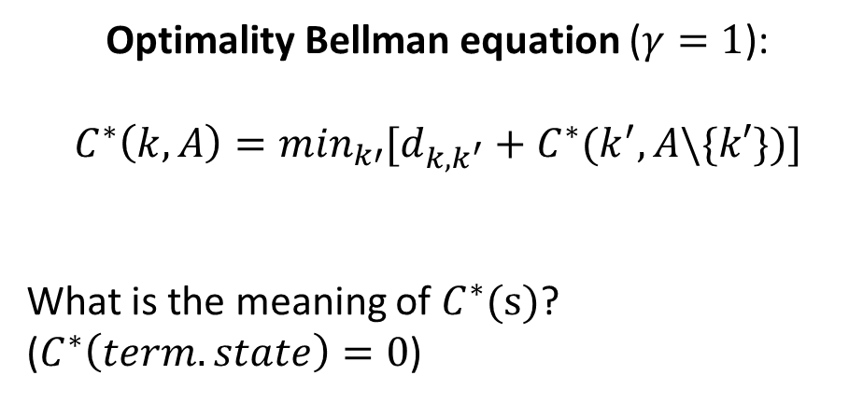
As a Markov Decision Process
Current city I’m in
States: $s=\left(k, A\right)$
List of cities still to be visited
Optimality Bellman equation ($γ=1$):
$$C^{∗}\left(k,A\right)=\min_{k′}[d_{k,k^{′}}+C^{∗}(k^{′},A\backslash \{k′\})]$$
What is the meaning of $C^{∗}(s)$?
($C^{∗}\left(term. state\right)=0$)

Slide 15
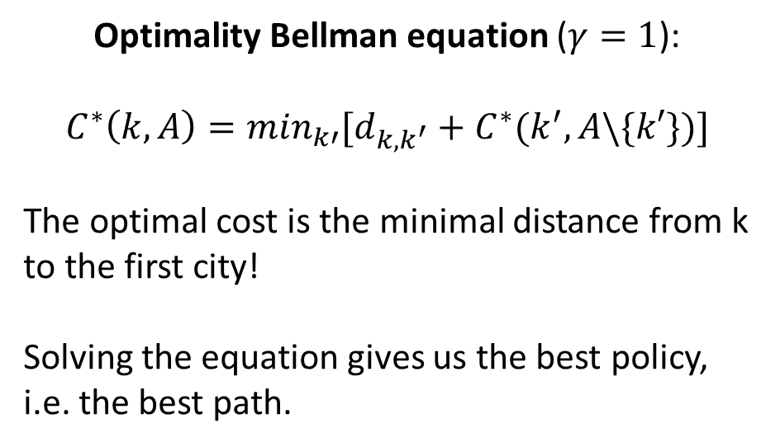
As a Markov Decision Process
Current city I’m in
States: $s=\left(k, A\right)$
List of cities still to be visited
Optimality Bellman equation ($γ=1$):
$$C^{∗}\left(k,A\right)=\min_{k′}[d_{k,k^{′}}+C^{∗}(k^{′},A\backslash \{k′\})]$$
The optimal cost is the minimal distance from k to the first city!
Solving the equation gives us the best policy, i.e. the best path.

Slide 16

How to solve the Bellman equation
Exploit the feedforward structure of the problem!
The cost of the states in this layer depends only on the costs in the next layer (and the distances)
$$C^{∗}\left(k,A\right)=\min_{k′}[d_{k,k^{′}}+C^{∗}(k^{′},A\backslash \{k′\})]$$

Slide 17

How to solve the Bellman equation
Exploit the feedforward structure of the problem!
Knowing the boundary condition at terminal state, the solution can be propagated backward for all the states
$$C^{∗}\left(k,A\right)=\min_{k′}[d_{k,k^{′}}+C^{∗}(k^{′},A\backslash \{k′\})]$$
$$C^{∗}\left(term. state\right)=0$$

Slide 18
How to find the best path
Once the costs are known, the best path$,$ $k_{1}^{∗}, k_{2}^{∗}, …,k_{N}^{∗}$, can be computed iteratively (now going forward) by knowing:
$$k_{t+1}^{∗}={argmin}_{k′∈A_{t}}[d_{k_{t},k}+C^{∗}(k,A\backslash \{k\})]$$

